Slide 1
This is Your Brain on Drugs
AKA: Neuropsychopharmacology

Slide 3
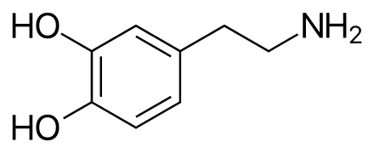
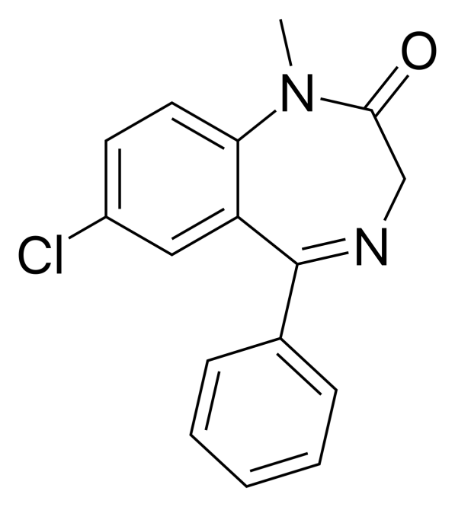
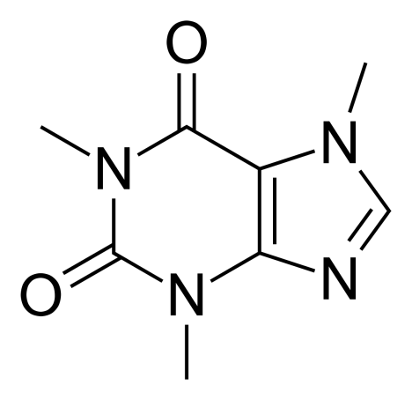
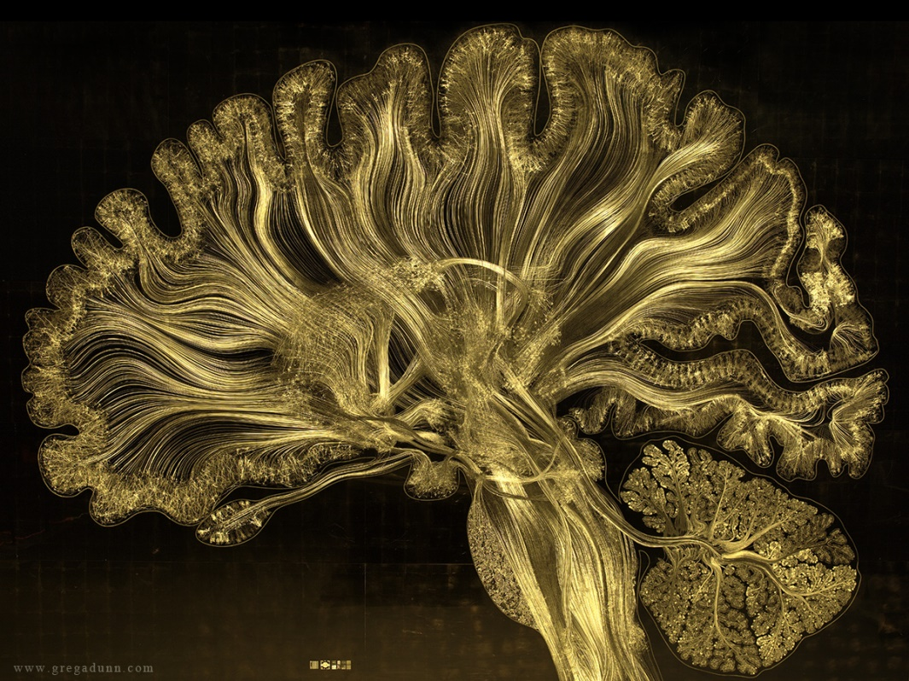

Slide 4
“Learning Goals” or Something Pretentious Like That
Drugs aren’t magic – they work on existing neurological systems
Drugs are neither good nor bad
Drug use can be therapeutic, non-problematic, or problematic
Information is good

Slide 5
Some statistics:
By graduation –
1 in 2 of you will have used an illicit drug (including marijuana)
1 in 5 of you will have used an illicit drug that is not marijuana
Nearly half of you will have smoked marijuana
1 in 5 of you will have used a prescription drug (not prescribed)
1 in 10 of you will have used amphetamines (Adderall)
1 in 12 of you will have used benzodiazepines (Valium, Xanax, etc)
60% of you will have drank alcohol
Nearly half of you will have gotten drunk
1 in 10 of you have binge drank in the last two weeks
30% of you will have smoked a cigarette
1 in every 3 will have used an e-cigarette
Source: The Monitoring the Future study, 2016 data, University of Michigan

Slide 6
Neuropsychopharmacology
The study of chemical substances that act upon the nervous system to alter behavior
Behavior includes mood, cognition, actions, etc

Slide 7
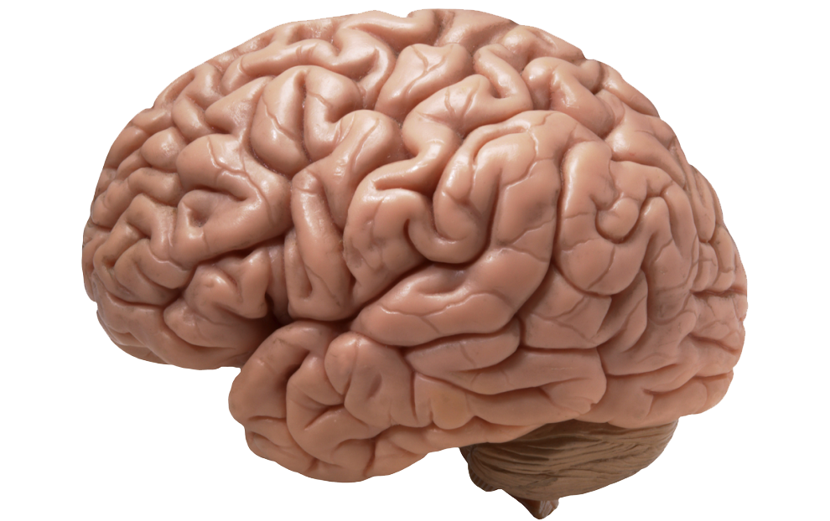
Neurotransmission
=

Slide 8
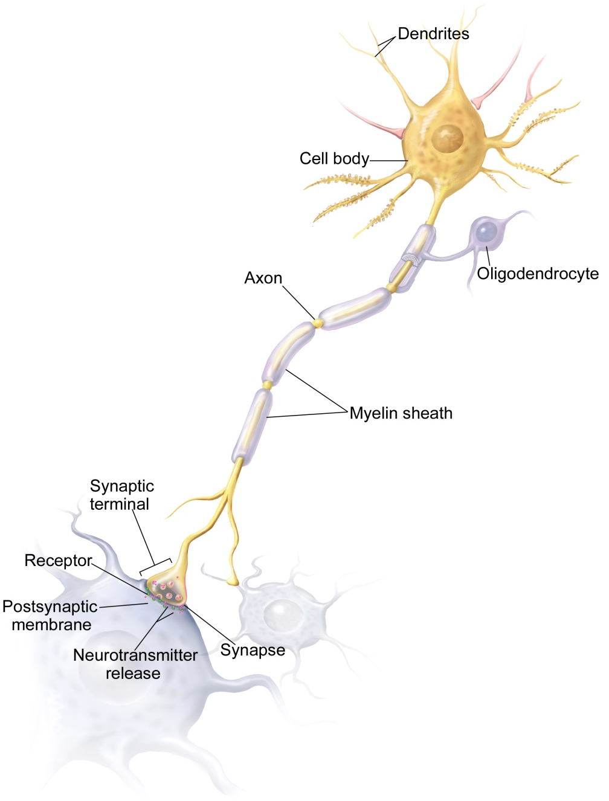
How are the messages sent?

Slide 9
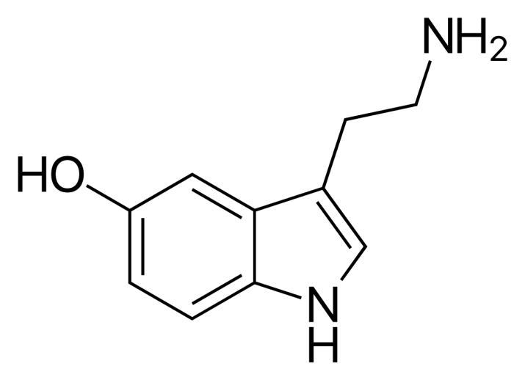
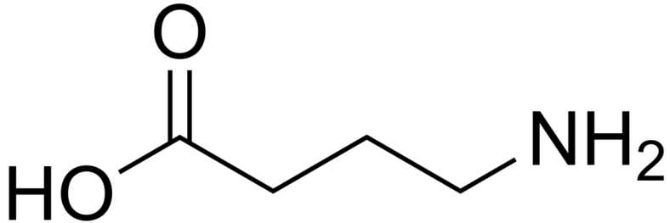
Neurotransmitters
Dopamine (DA)
GABA
Reward, motor function
Schizophrenia, Parkinson’s
Cocaine, amphetamines
Serotonin
(5-HT)
Inhibition
Anxiety, seizures, insomnia
Alcohol,
Benzodiazepines (Valium, Xanax)
Mood, satiety
Depression, OCD
SSRIs, MDMA (Ecstasy)

Slide 10
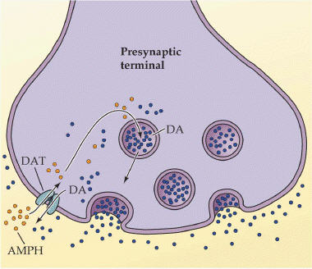
Drug action: Specific molecular changes produced by a drug when it binds to a target or receptor
Drug effects: Resulting widespread alterations in physiological or psychological functioning
Example: Amphetamine reverses the dopamine transporter, increasing DA levels in the synapse
→ leading to increased alertness, wakefulness, and locomotion, which is useful in treating narcolepsy and ADHD.
ACTION
EFFECT

Slide 11
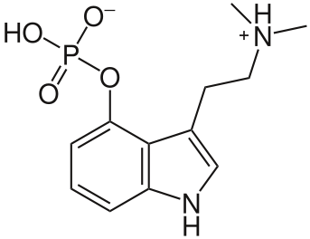
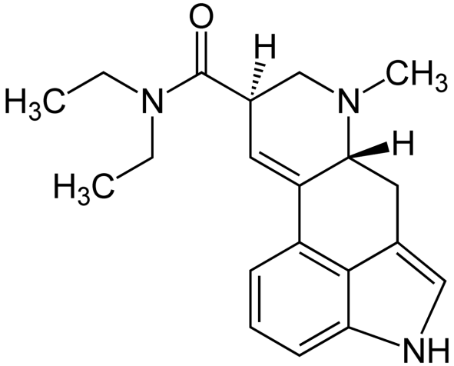
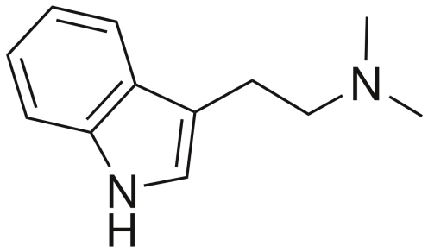
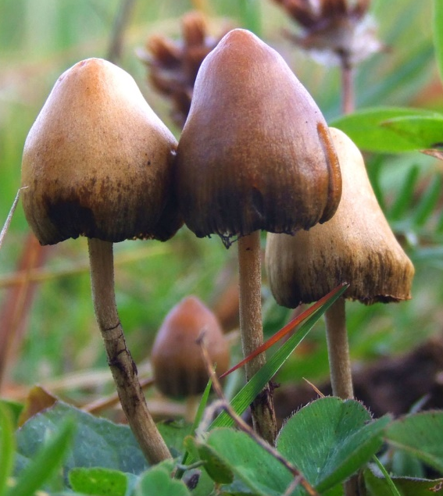
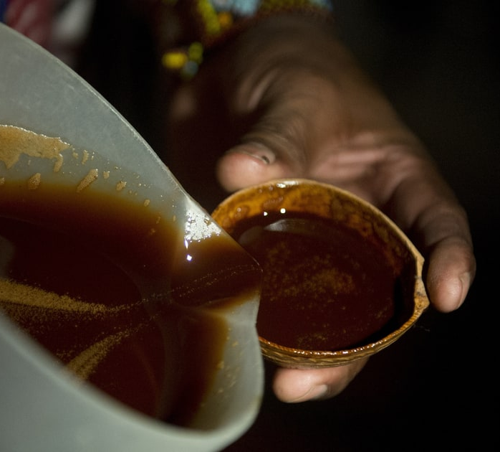
Agents Imitate NT Structure
“Lock and key”
5-HT or Serotonin
LSD
Psilocybin
DMT

Slide 12
Agonists and Antagonists
Agonist: Binds to and activates a receptor
Antagonist: Binds to and blocks a receptor

Slide 13
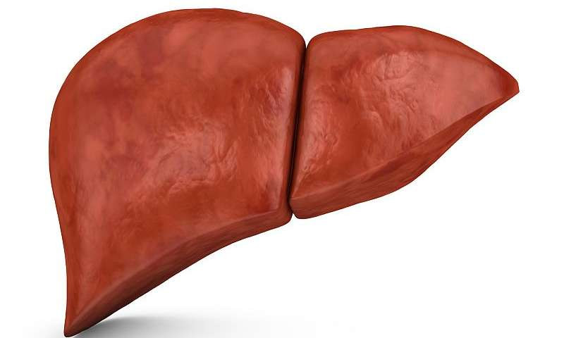
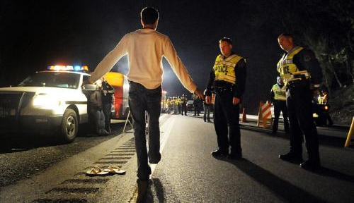
Tolerance
Tolerance: Chronic use results in diminished drug effect/potency, requires higher dosages to maintain constant effect

Slide 14
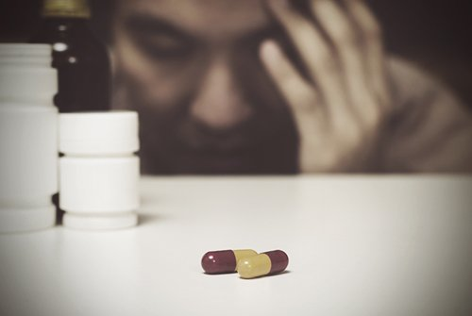
Dependence: Physical quality characterized by withdrawal symptoms or the avoidance of withdrawal upon cessation
Withdrawal: A group of symptoms which occur upon abrupt cessation of a drug which has typically been used in either high doses or over a long period of time

Slide 15
Hemingfield Ratings
Substance | Withdrawal | Tolerance | Dependence | Intoxication
Nicotine | 3 | 2 | 1 | 5
Heroin | 2 | 1 | 2 | 2
Cocaine | 4 | 4 | 3 | 3
Alcohol | 1 | 3 | 4 | 1
Caffeine | 5 | 5 | 5 | 6
Marijuana | 6 | 6 | 6 | 4
Notes:
Alcohol withdrawal is more dangerous, but opiate use is more dangerous
Even though alcohol is more abused
Marijuana is less addictive than even caffeine

Slide 16
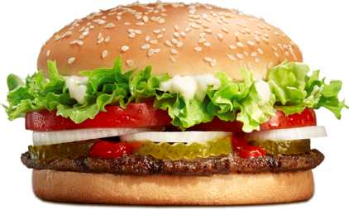
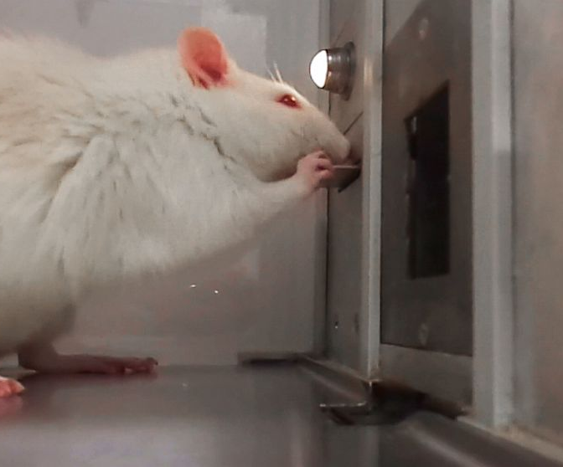
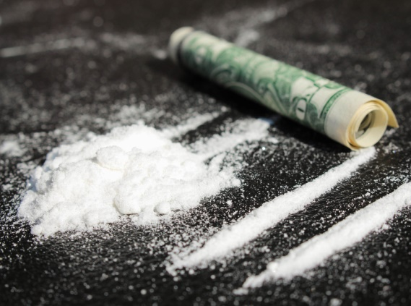
Reward

Slide 17
Opponent-Process Model
GABA is the brain’s primary inhibitory NT
Alcohol works by increasing the effect of GABA
Effects of alcohol include euphoria, sedation, impaired functioning
Withdrawal from alcohol causes over-excitation in the brain, leading to seizures, anxiety, tachycardia, tremors

Slide 18
Addiction
Addiction is characterized by:
Compulsive, drug-seeking behavior (craving)
Chronic relapsing and remissions
Persisting use despite negative consequences
Nearly 1 in 7 Americans will develop a substance use disorder in their lifetime, but only 10% will receive specialty treatment.

Slide 19
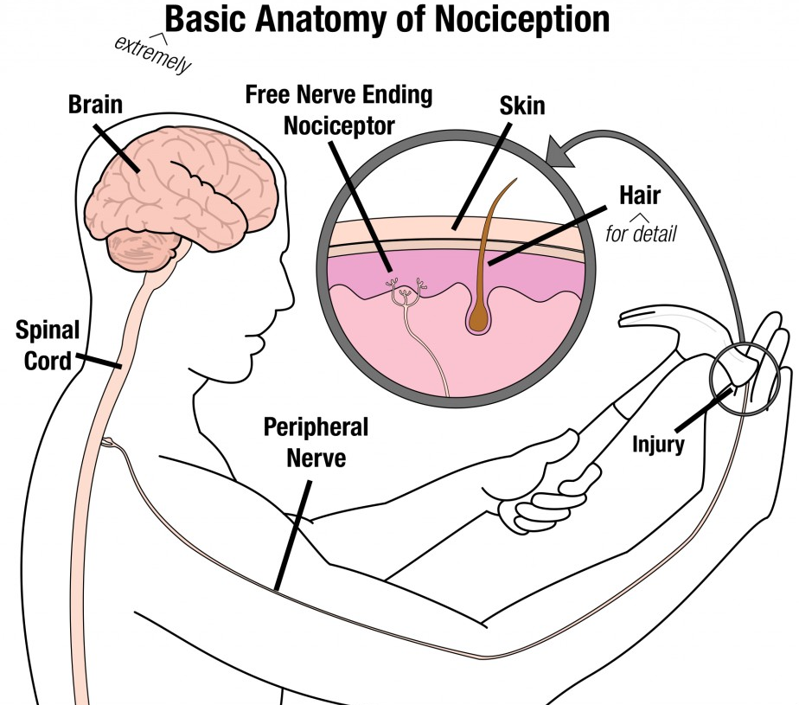
Opioid Drug Action
Nociception: The nervous system’s perception of and response to harmful stimuli
Opioids relieve pain, which is known as analgesia

Slide 20
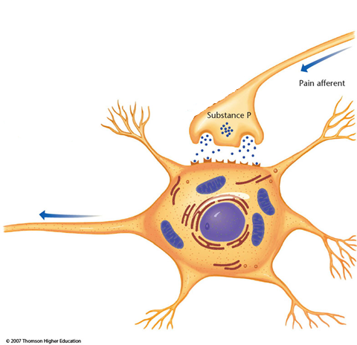
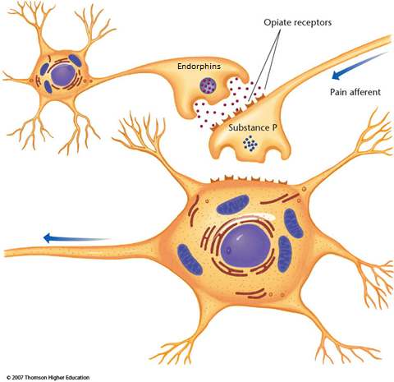
Opioid Drug Action
Opioids are agonists of the μ-opioid receptors
Examples include hydrocodone,
μ-opioid receptors
oxycodone, morphine, heroin, fentanyl, and methadone

Slide 21
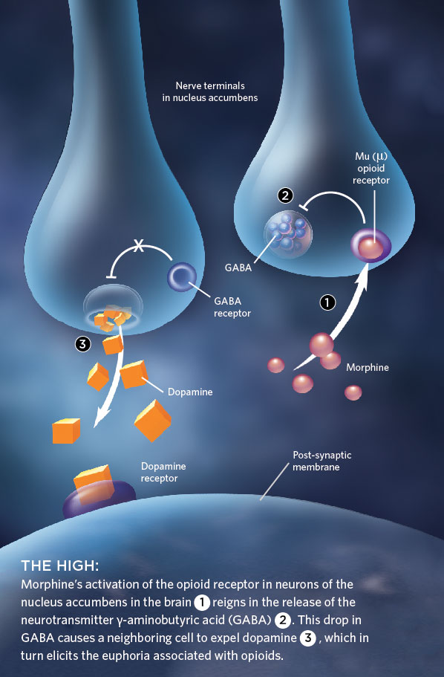
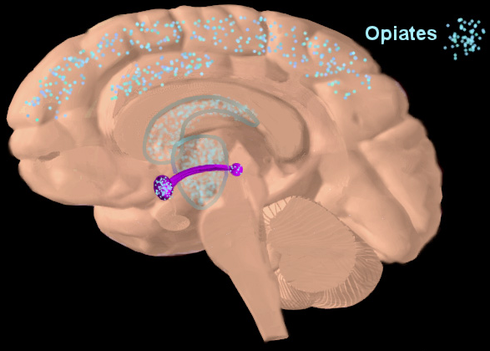
Opioid Drug Action
Reinforcement of opioid addiction comes from the dopaminergic reward system
Nucleus accumbens
VTA
Notes:
“Morphine’s activation of the opioid receptor in neurons of NA reigns in release of GABA, drop in GABA causes neighboring cell to expel DA, which elicits euphoria associated with opioids”

Slide 22
Opioid Drug Effects
Drug Effect
Analgesia
Constipation
Respiratory depression
Euphoria
Relaxation and sleep
Tranquilization
Decreased blood pressure
Pupil constriction
Hypothermia
Drying of secretions
Reduced sex drive
Flushed and warm skin

Slide 23
Opioid Drug Effects
Drug Effect | Withdrawal Sign
Analgesia | Pain and irritability
Constipation | Diarrhea
Respiratory depression | Panting and yawning
Euphoria | Dysphoria/depression
Relaxation and sleep | Restlessness and insomnia
Tranquilization | Fearfulness and hostility
Decreased blood pressure | Increased blood pressure
Pupil constriction | Pupil dilation
Hypothermia | Hyperthermia
Drying of secretions | Tearing, runny nose
Reduced sex drive | Spontaneous ejaculation
Flushed and warm skin | Chilliness and “gooseflesh”

Slide 24
Opioid Addiction
17 y/o
15 y/o
Notes:
One subject 17, another 15 at first use

Slide 25
Drug Overdose Deaths in America
Source: National Institute on Drug Abuse and CDC

Slide 26
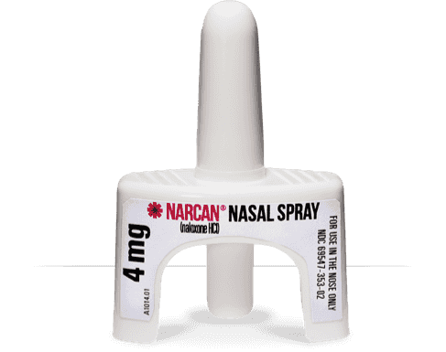
Naloxone
Naloxone (Narcan) is a μ-opioid receptor antagonist
Notes:
Naloxone is available OTC in 41 states (including MA) – for $109
A single dose of heroin costs $15-$20
The wholesale price of two doses of Narcan would be between $1 and $10

Slide 27
Society
How should we treat America’s ~100 million chronic pain patients?
Should it be illegal to be addicted?
Should we provide needle exchanges for users?
Should we administer Narcan to the same patient dozens of times?
Should we provide supervised injection facilities and “prescription heroin”, like Canada, Switzerland, Germany, and the Netherlands?
Would any of these services incentivize drug use?
Where would the money come from to fund these programs?
Who’s to blame for the “opioid epidemic” – doctors, pharmaceutical companies, insurers, the government, traffickers, dealers, users, patients...?

Slide 28
Notes:
https://www.youtube.com/watch?v=QaNM2hiWKQ8&

Slide 29
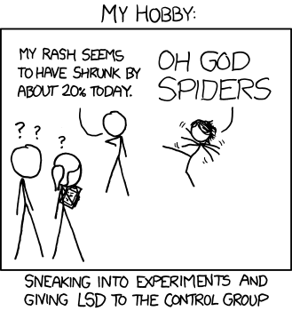
Questions?

Slide 30
How do we classify drugs?
Stimulants
Caffeine, cocaine, amphetamines, nicotine
Depressants
Alcohol, benzodiazepines, barbiturates
Hallucinogens
Psychedelics, dissociatives, empathogen-entactogens
LSD, psilocybin, DMT, salvia, ketamine, PCP, NO, DXM, MDMA
Analgesics
Opioids
Neuropsychiatric medication
Antidepressants, antipsychotics, mood stabilizers, hypnotics
SSRIs, MAOIs, haloperidol, lithium, Ambien
Also psychostimulants, anxiolytics
Adderall, Ritalin, Xanax, Valium

Slide 31
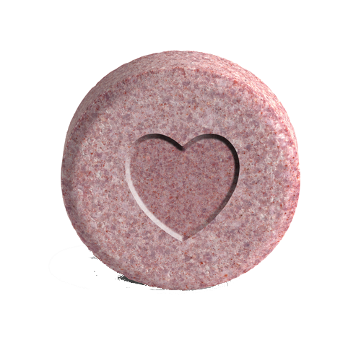
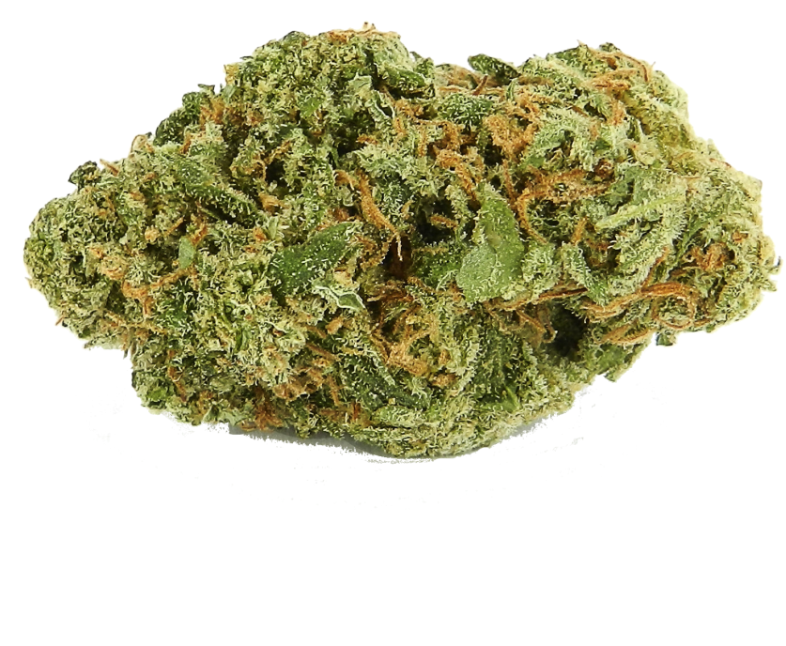
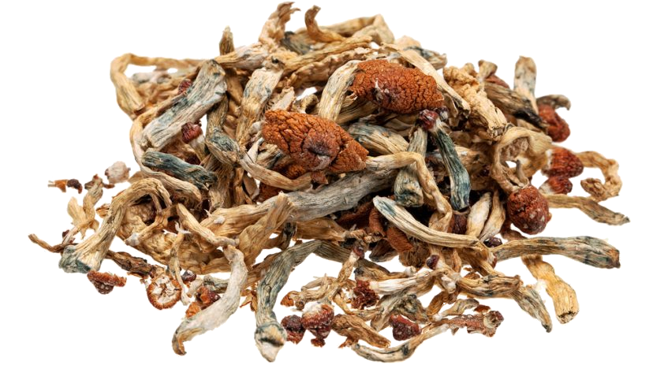
Are psychedelics just for hippies?
Psilocybin (“magic mushrooms”) is being looked into as a treatment for cluster headaches, addiction, depression in terminal patients
MDMA (“ecstasy”) is being looked into for psychedelic-assisted psychotherapy for treatment-resistant PTSD
Marijuana has been proven as a treatment for chronic pain, Multiple Sclerosis-associated symptoms, nausea/vomiting from chemotherapy, and drug-resistant epilepsy

Slide 32
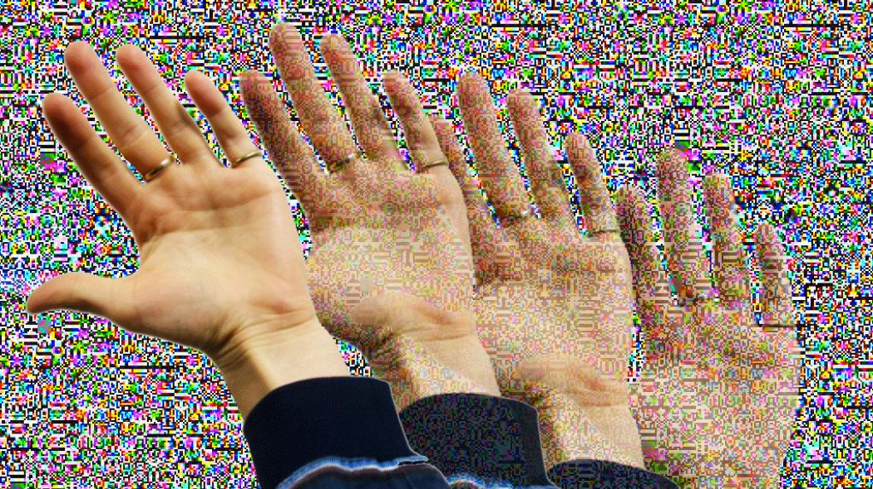
Are psychedelics safe?
Hallucinatory persisting perception disorder (HPPD)
Notes:
Only like 4%

Slide 33
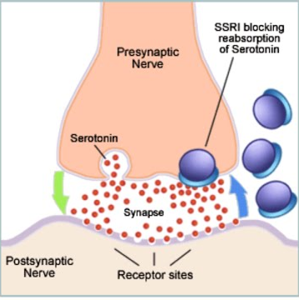
What does SSRI mean?
Selective Serotonin Reuptake Inhibitor
Ex. Prozac, Zoloft, Paxil, Lexapro, Celexa
MDD, GAD, OCD

Slide 34
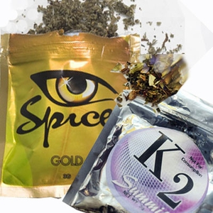
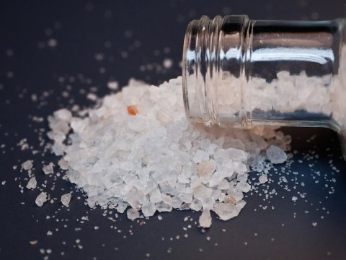
What are “designer drugs”?
“Research chemicals”, “legal highs”, or analogs
Spice, K2, bath salts, etc

